Slide 1
PROJECT -1 ANALYZING AMAZON SALES DATA

Slide 2
OVERVIEW
To create a dashboard using Power BI to track and analyze Amazon Sales data and generate insights for their business.

Slide 3
PROJECT KEYPOINTS
Data Collection
Data Cleaning & Wrangling
Data Modeling
Data Visualization
Dashboard Design
Sharing Insights

Slide 4
STEPS INVOLVED IN POWER BI
Load Raw Data from Excel/CSV files
Transform Data using Power Query
Report View to analyze data
Table view to modify/manipulate data as per requirements
Model View to establish a relationship between source data

Slide 5

PROJECT LEARNINGS
Created an interactive dashboard to track and analyze online sales data
Used complex parameters to drill down in worksheet
Used different types of customized visualization (bar chart, pie chart, donut chart, clustered bar chart, line chart, etc)

Slide 6
DETAILS OF DATA
REGION
COUNTRY
ITEM TYPES
SALES CHANNEL
ORDER DATE
SHIP DATE
UNIT COST
UNIT PRICE
UNIT SOLDS

Slide 7
MAIN KPI’s
Total Revenue – Revenue for all units sold
Total Cost – Cost involved
Total Profit – Profit generated out of total

Slide 8
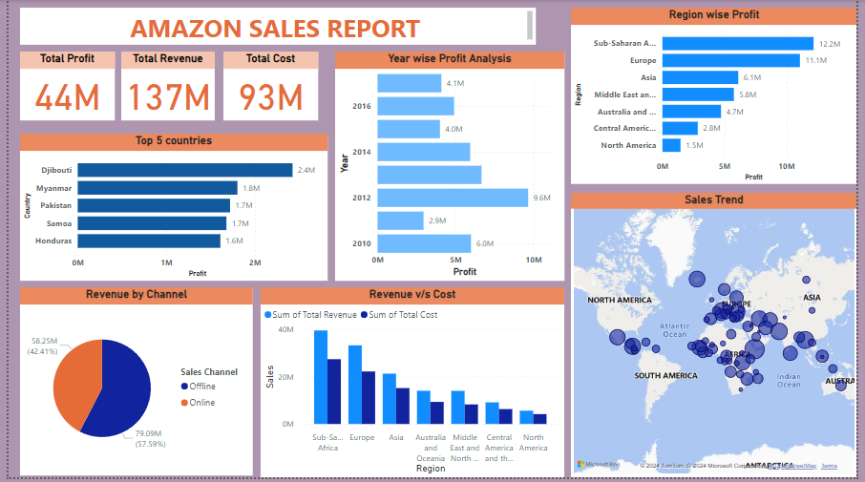
REPORT

Slide 9

INSIGHTS
Total Cost Incurred – 93M
Total Revenue Generated – 137M
Total Profit Achieved – 44M
Max Profit Year – 2012
Max Profit Region – Sub-Saharan Africa
Max Sales Generated by – Offline mode
Top performing country - Djibouti

Slide 10
Thank you

